Slide 1
SimaPro installation guide
Only for use in:
MSE-433, ME-203, ME-516
Cannot be for projects, including but not limited to:
used for semester projects, master’s projects, MAKE projects, PhD research, industrial projects

Slide 2
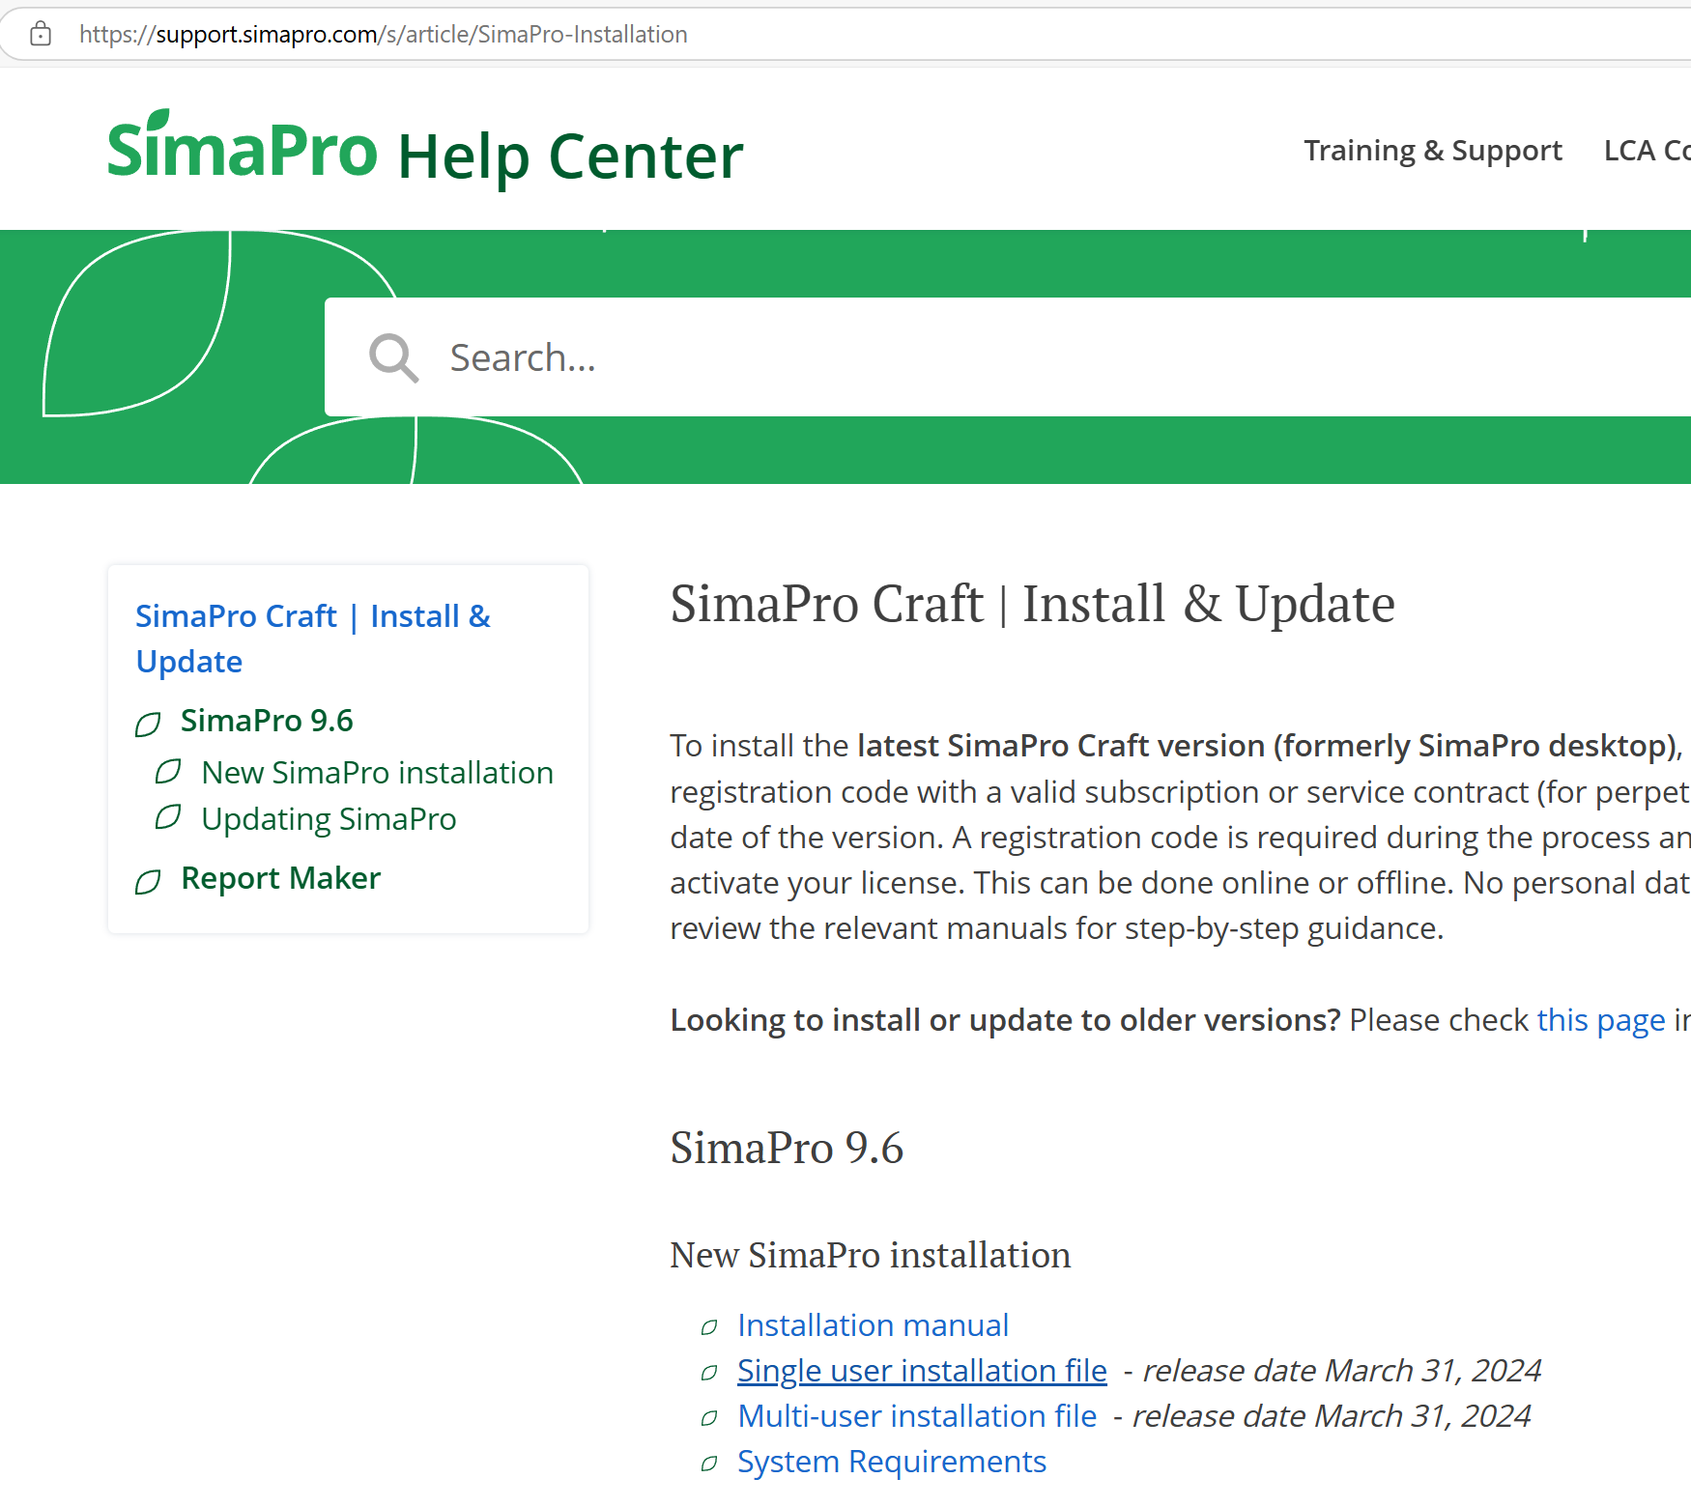

Slide 4
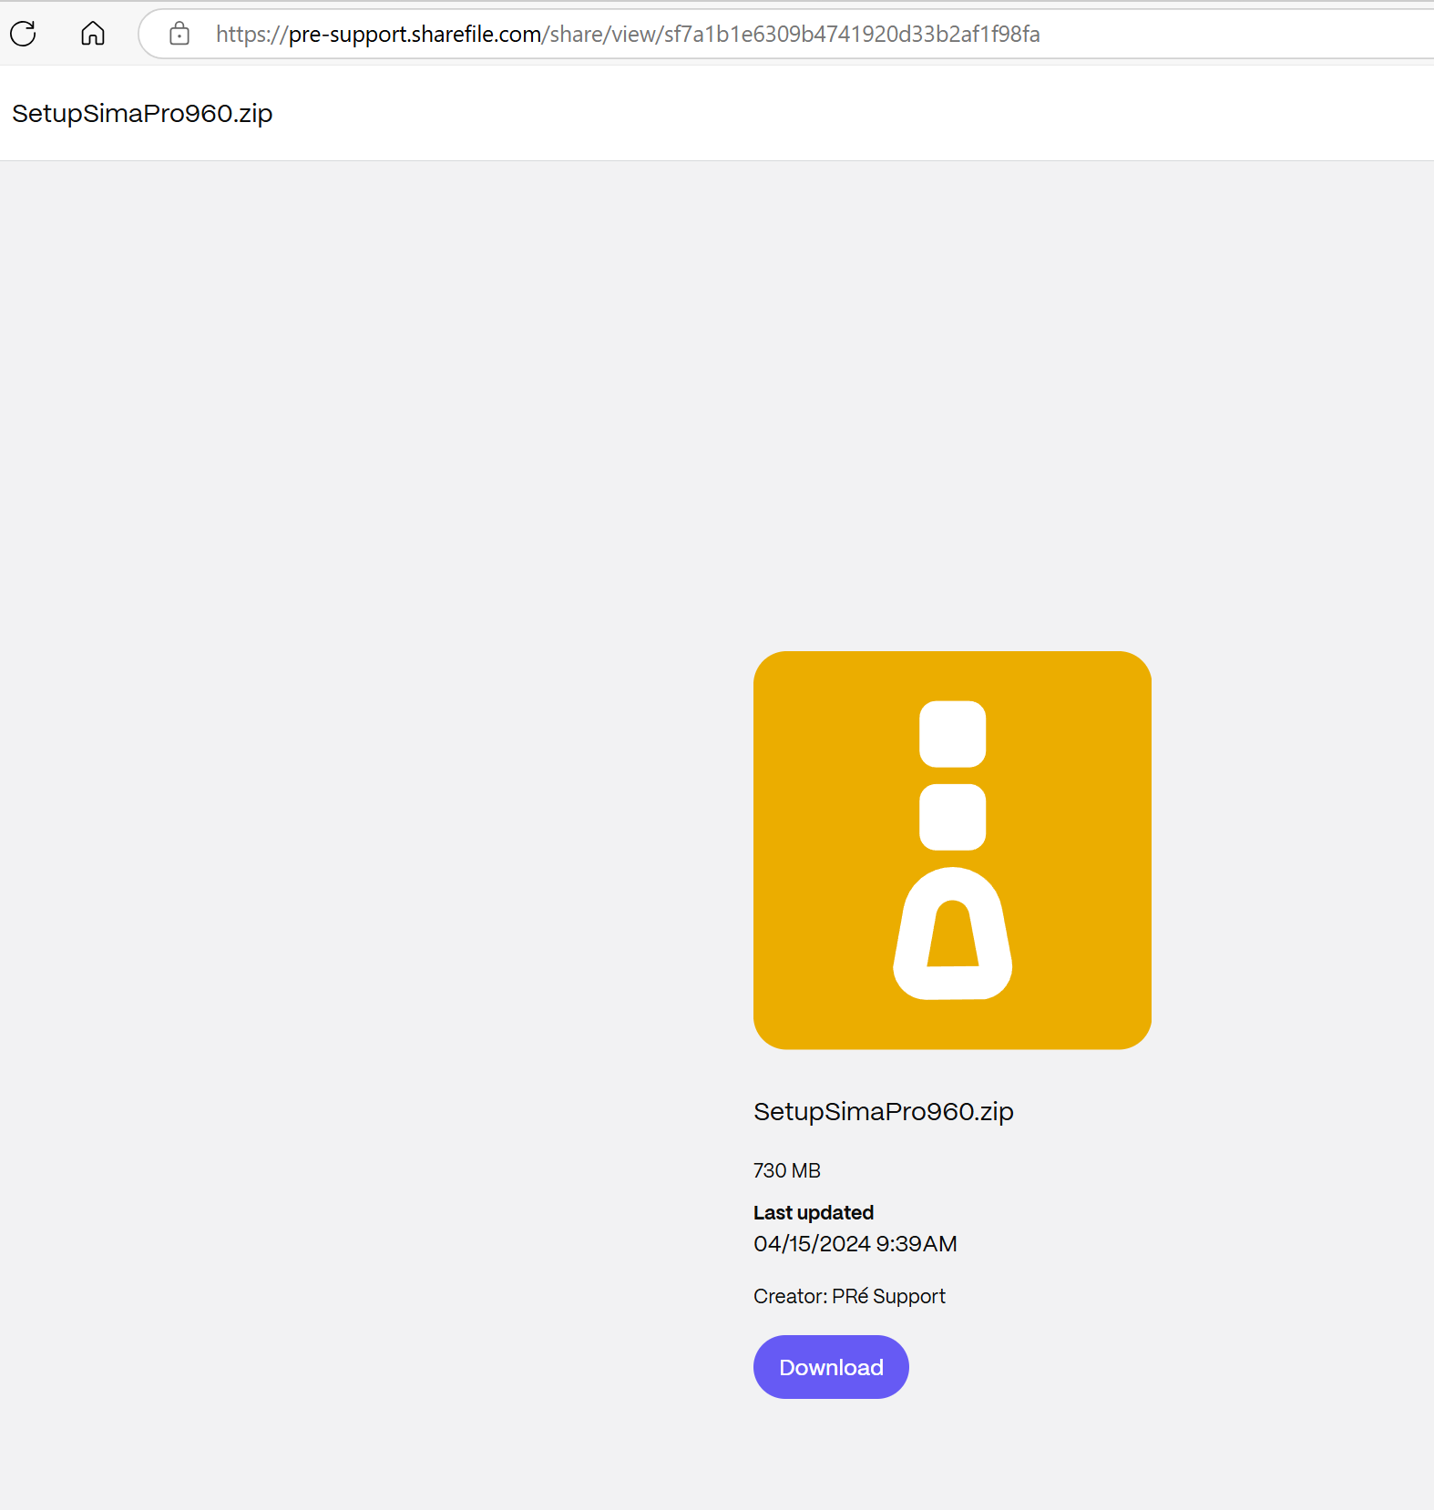

Slide 5
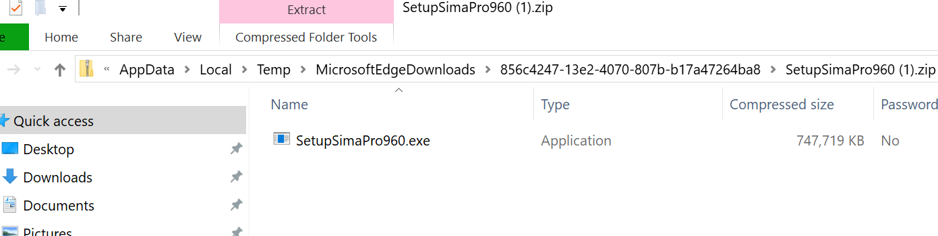
Double click on file to Install

Slide 6
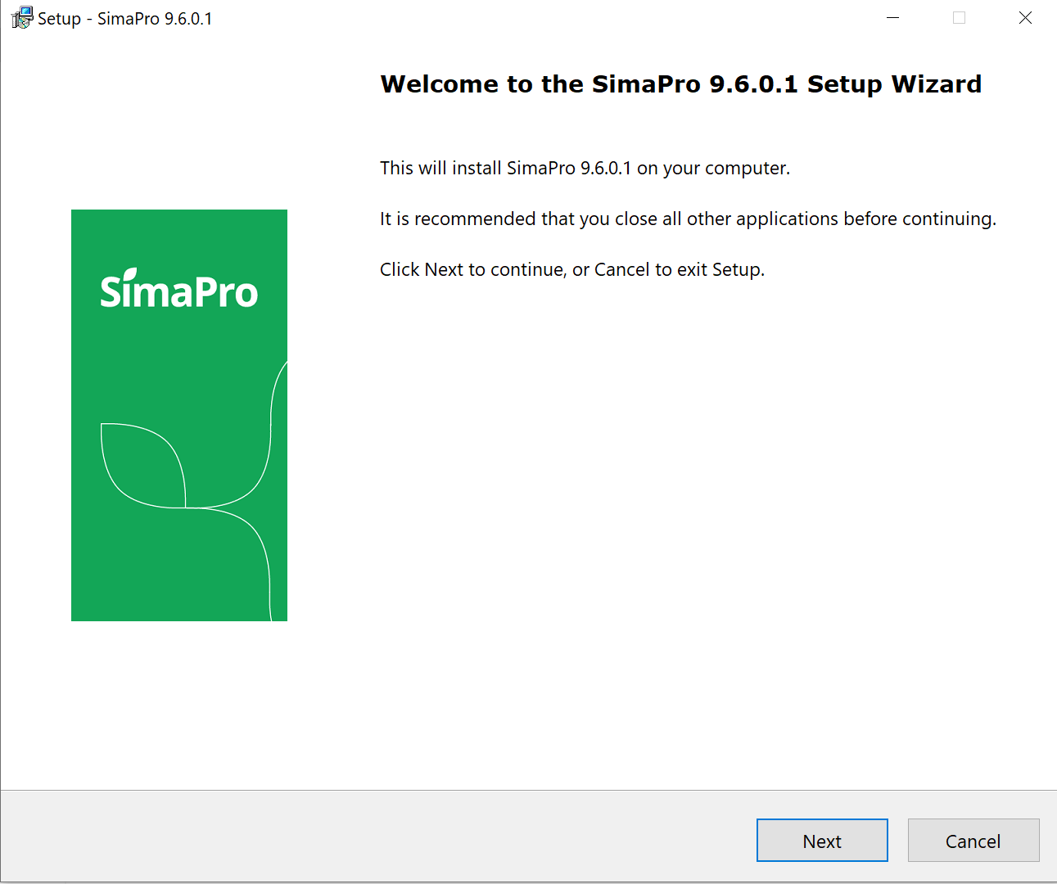

Slide 7
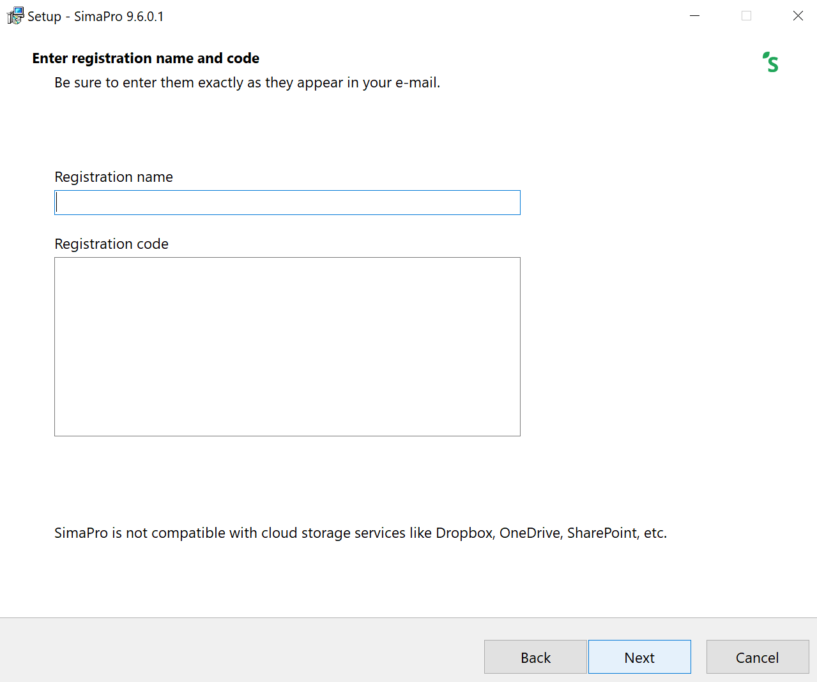

Slide 8
Enter this text, cut and paste
Registration name: STI Wakeman
Registration code:
YQkAAADcmgIAxY+ZJ5upAAgiAAA=#
ZoY+1aRt1rrDvkHEbAY+pJqAT1EYBZ+ByQsqVnbchlYAy/41ho
Yr72SOIzFZku8pJjih2463l5Jlon+F3vOG1F5ezhrXPKFrbXxX
Bms1+ZT+nNtgF1Dii8yXk115wvJ8iIQAcN9GFZLsHwqL7GkSmB
RwKldJ4JoOYFLXfD56lRk=

Slide 9
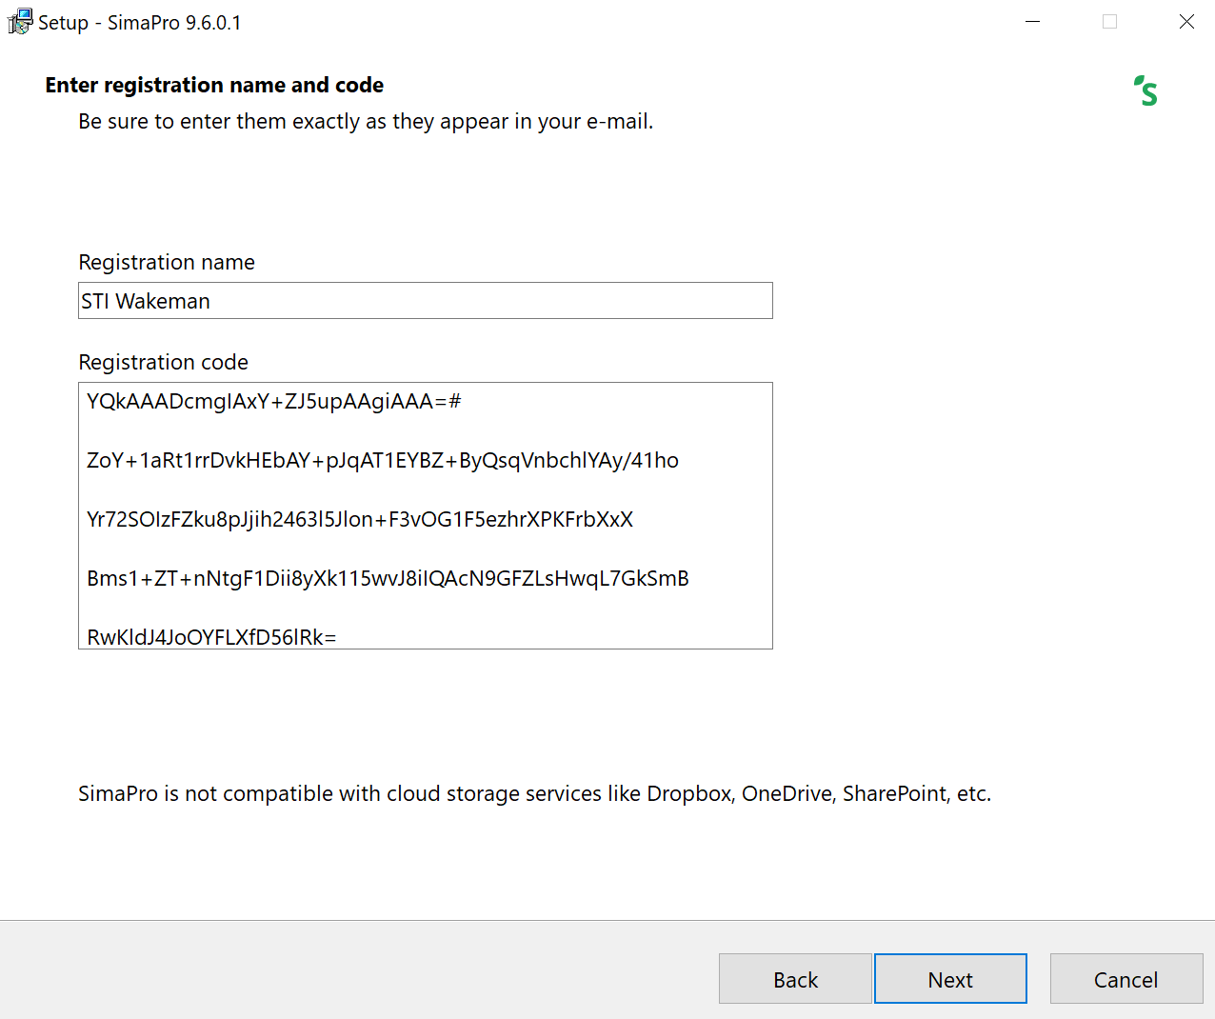

Slide 10
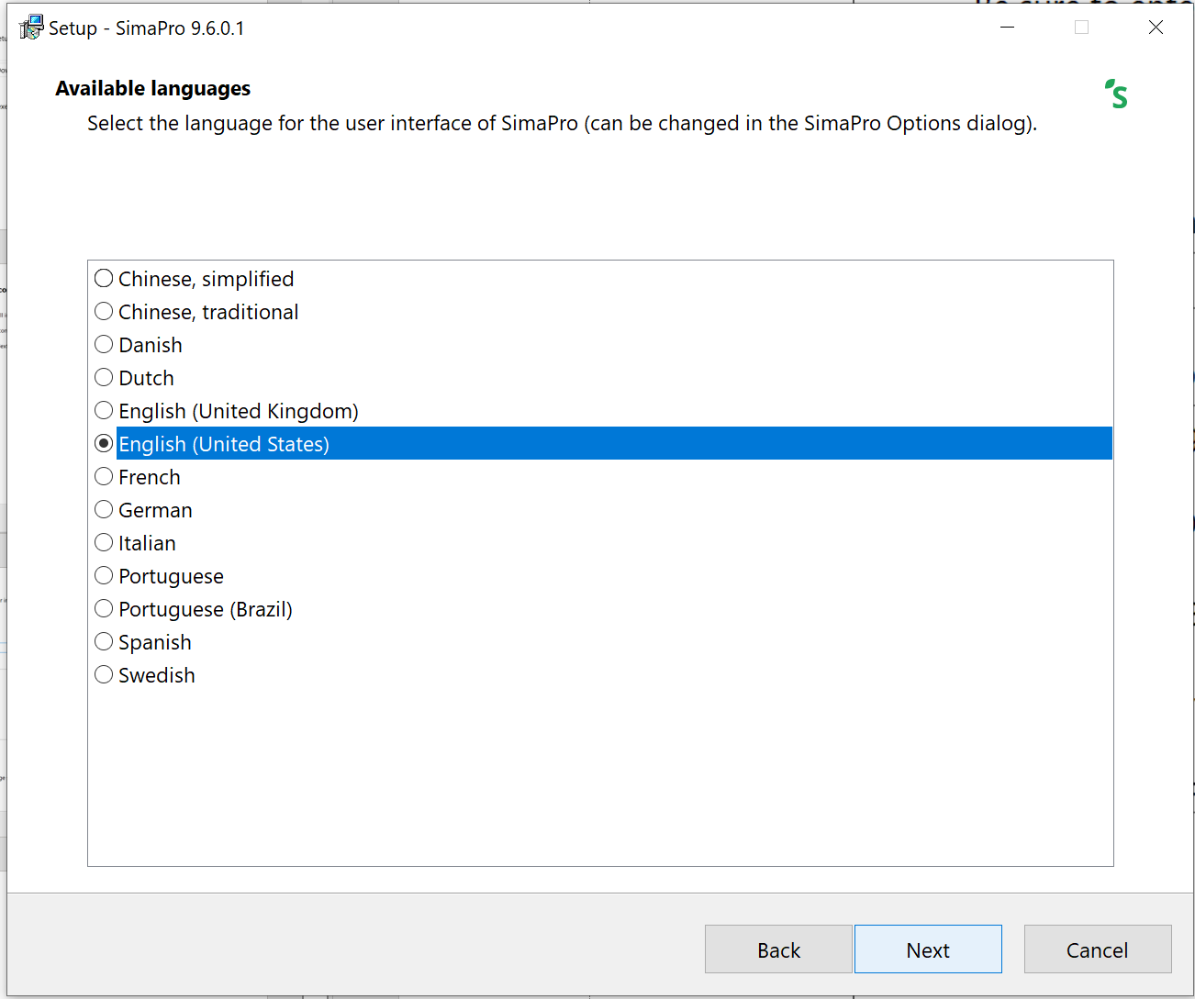

Slide 11
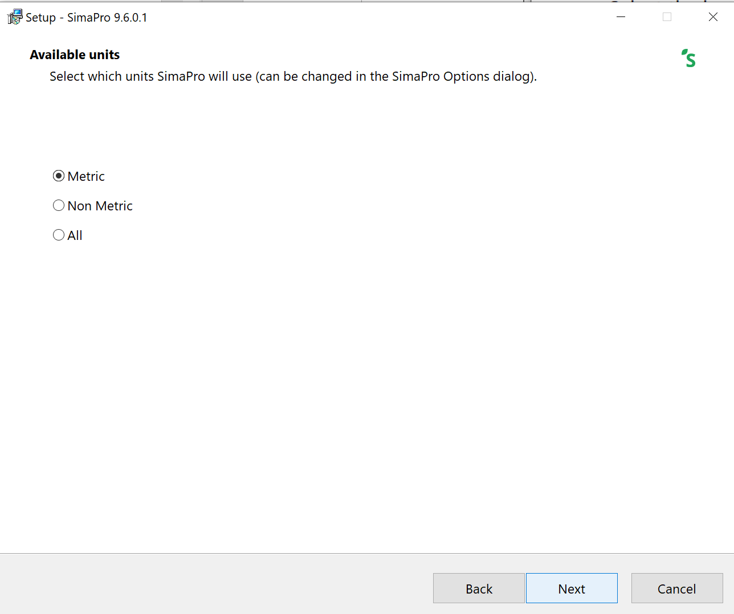

Slide 12
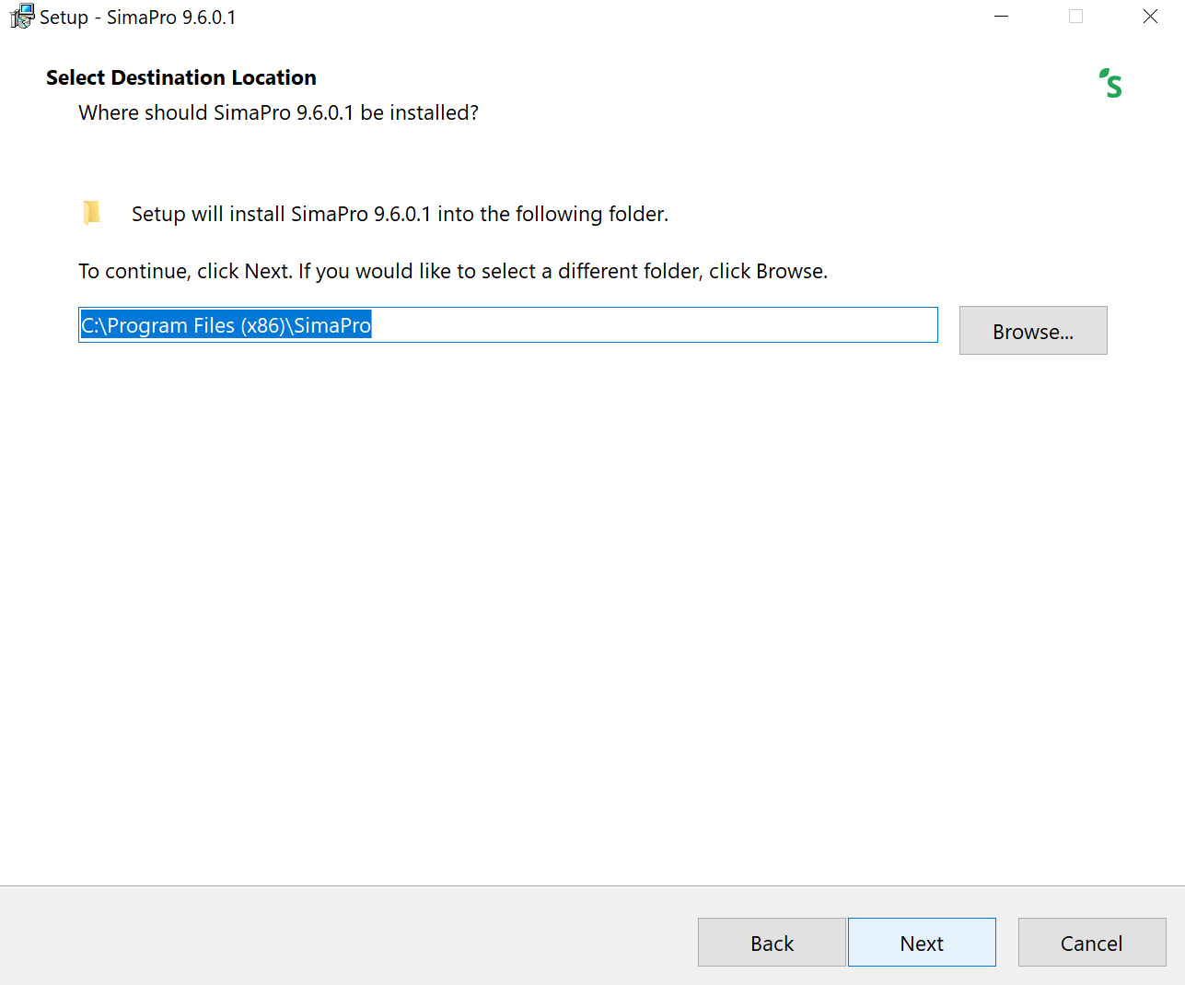

Slide 13
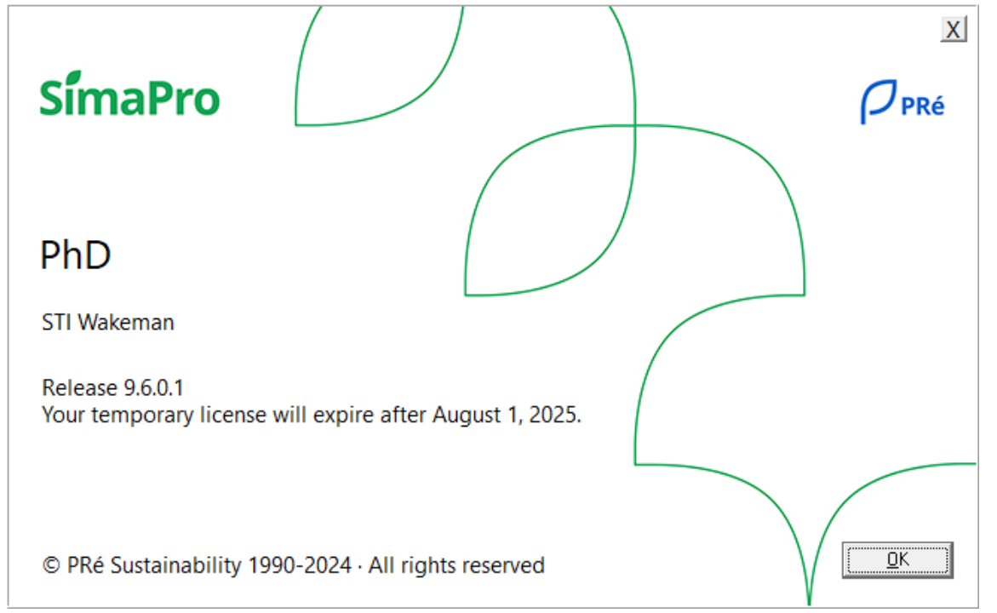

Slide 14
EN15804 database installation
Optional

Slide 15
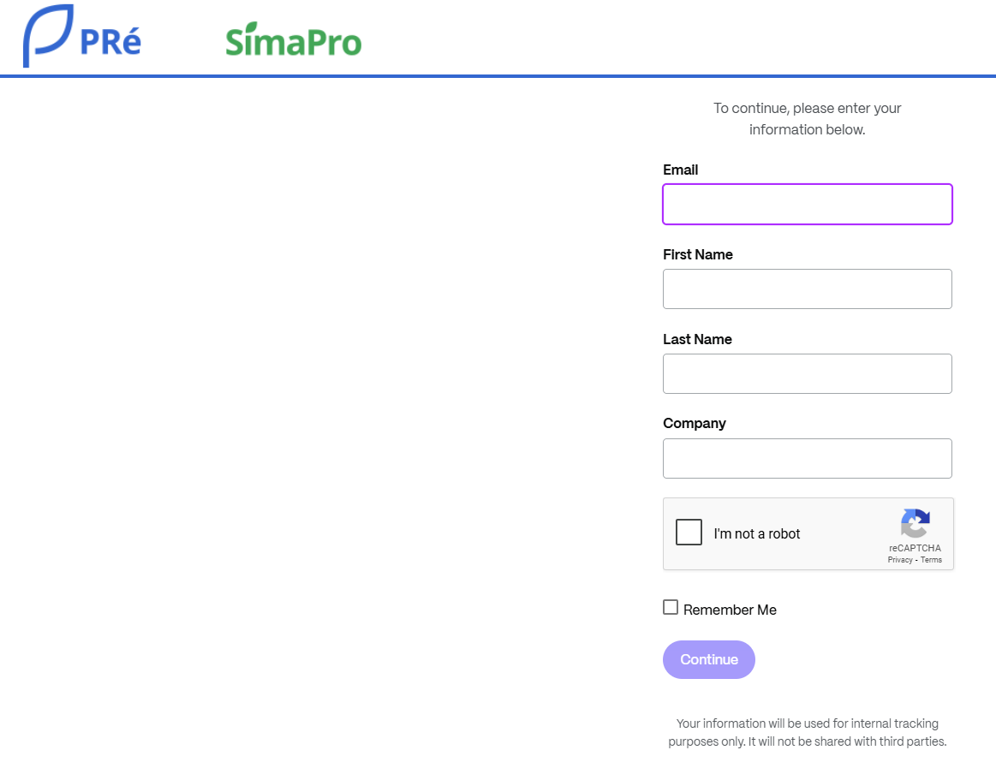
Follow the link below and fill in your information:
https://pre-support.sharefile.com/d-saa49ff6e213a458f8aac0f23df557800

Slide 16
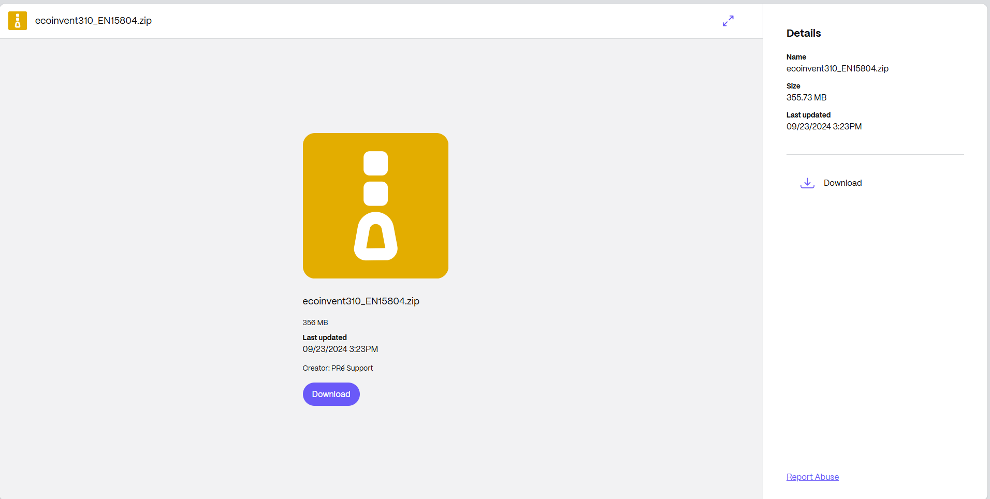

Slide 17
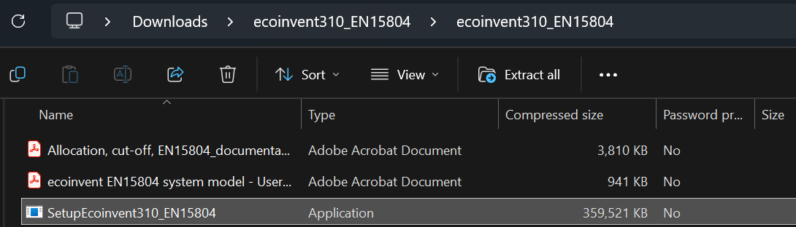
Double click on SetupEcoinvent310_EN15804 to install

Slide 18
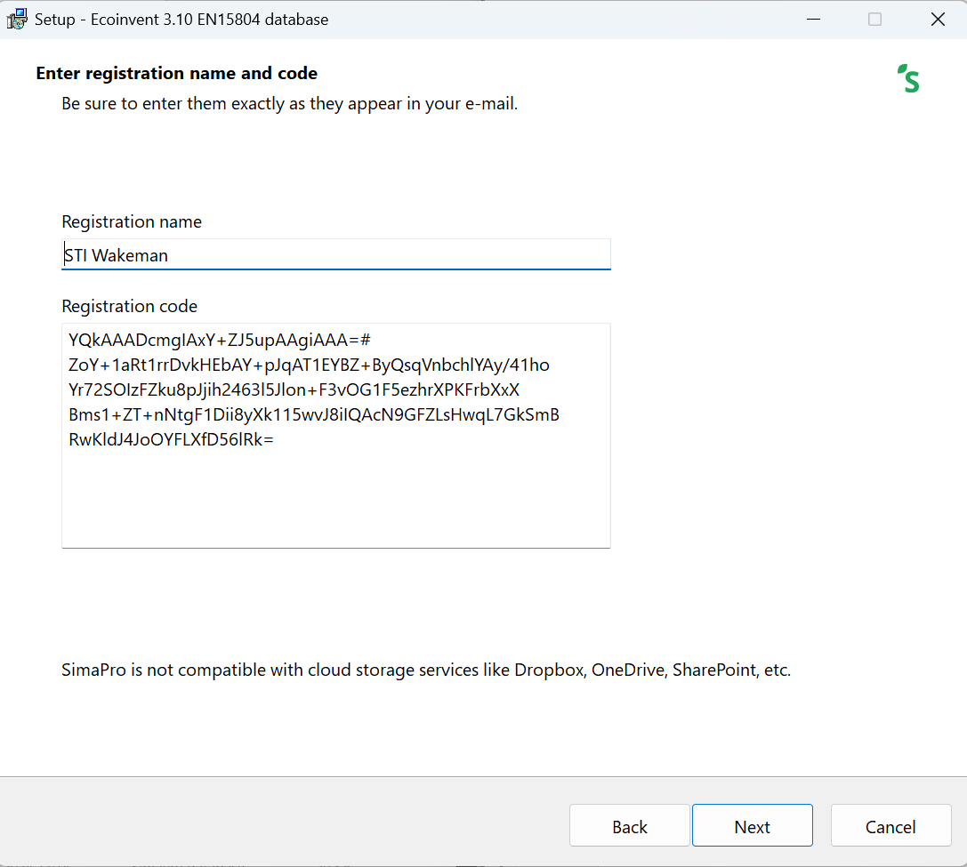

Slide 19
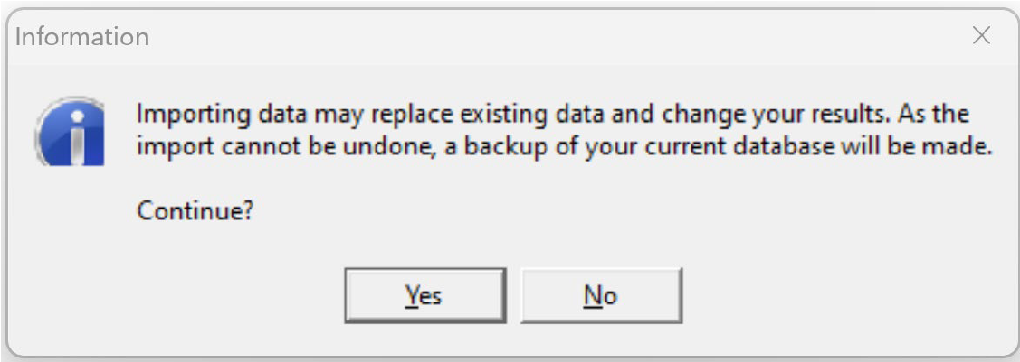
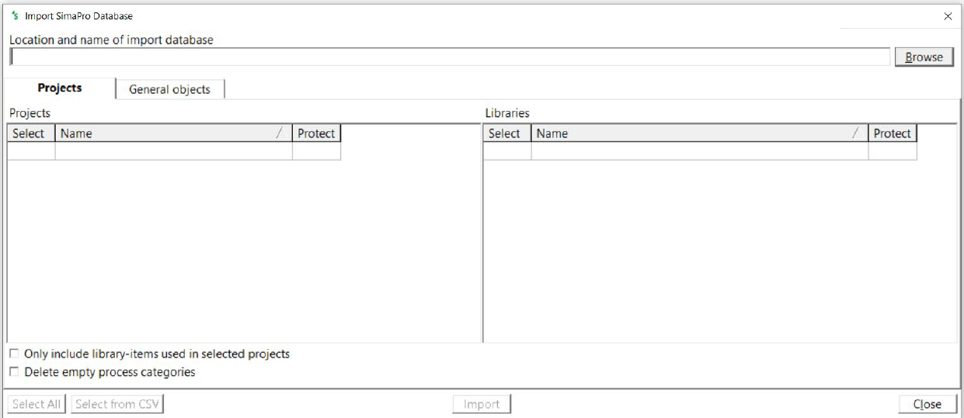
Open up SimaPro: Go to File > Import SimaPro Database

Slide 20
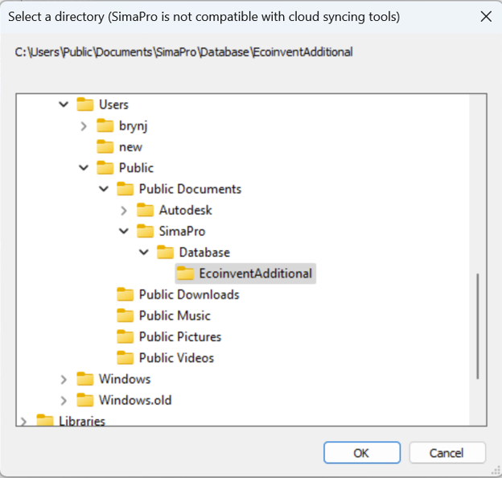
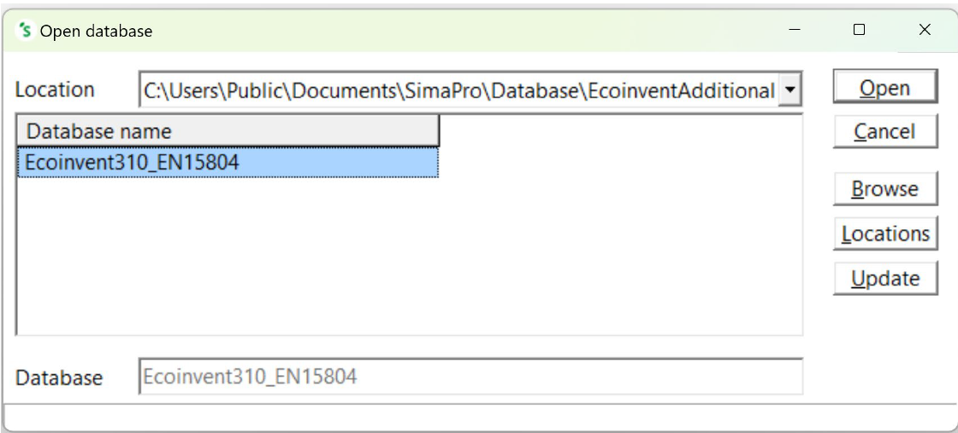
Browse to select the location where you have the database

Slide 21
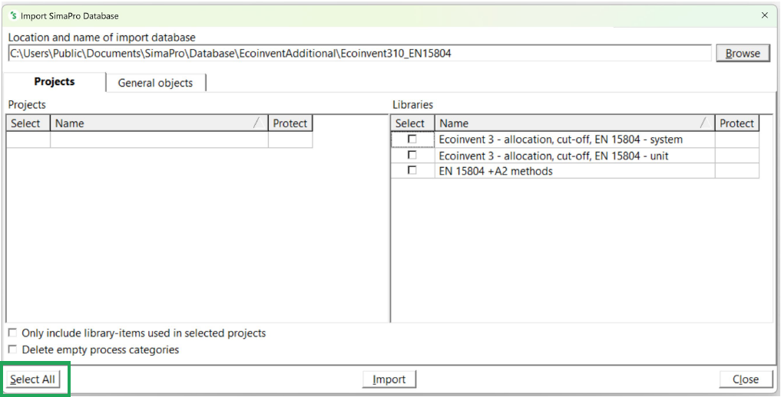
Click Select All and then Import

Slide 22
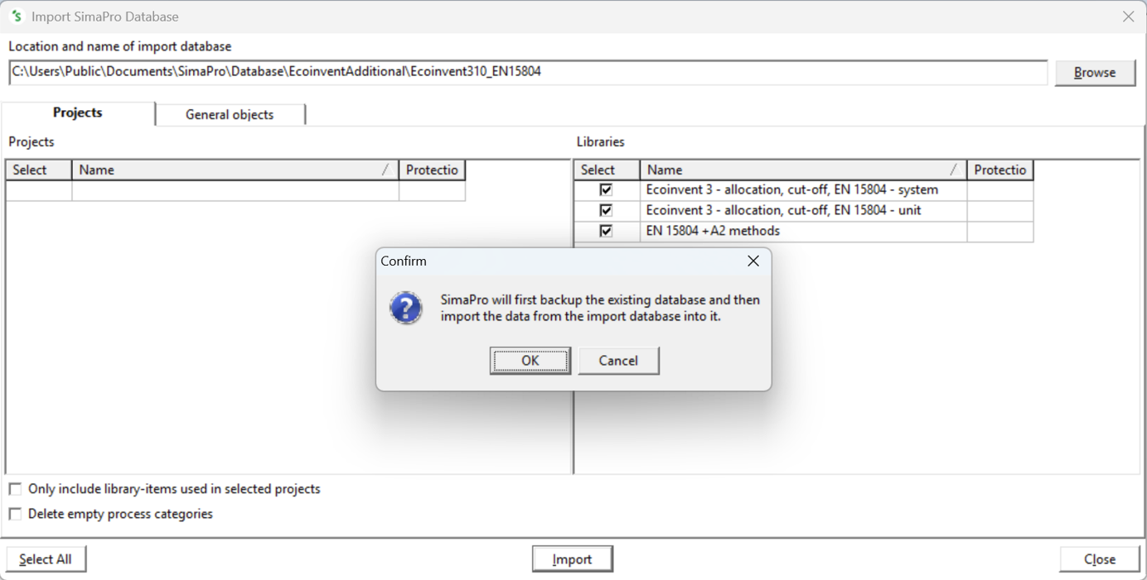
This can take some time (~20-30mins). SimaPro may seem unresponsive even when the update appears to be finished so please be patient as forcing SimaPro to shut down may risk database damage!

Slide 23
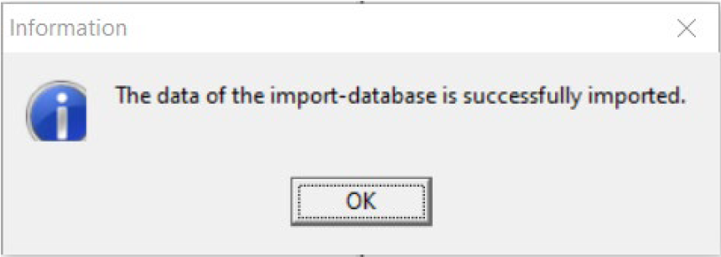
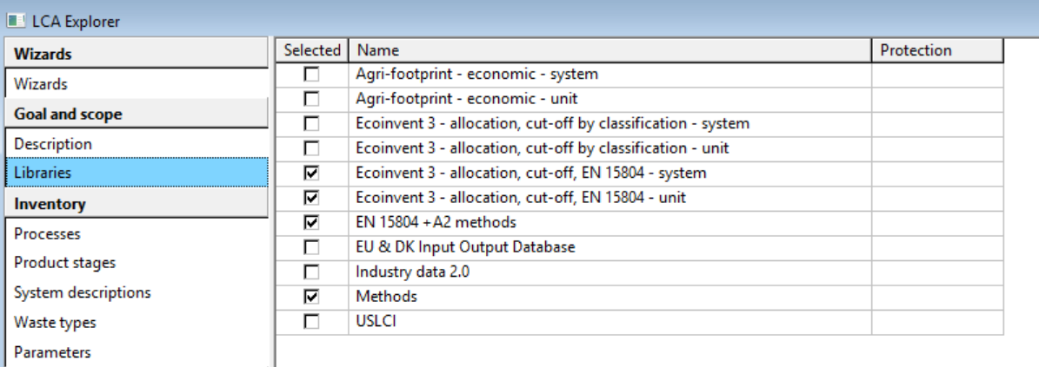
After the import procedure you should see the EN15804 data libraries in your list

Slide 24
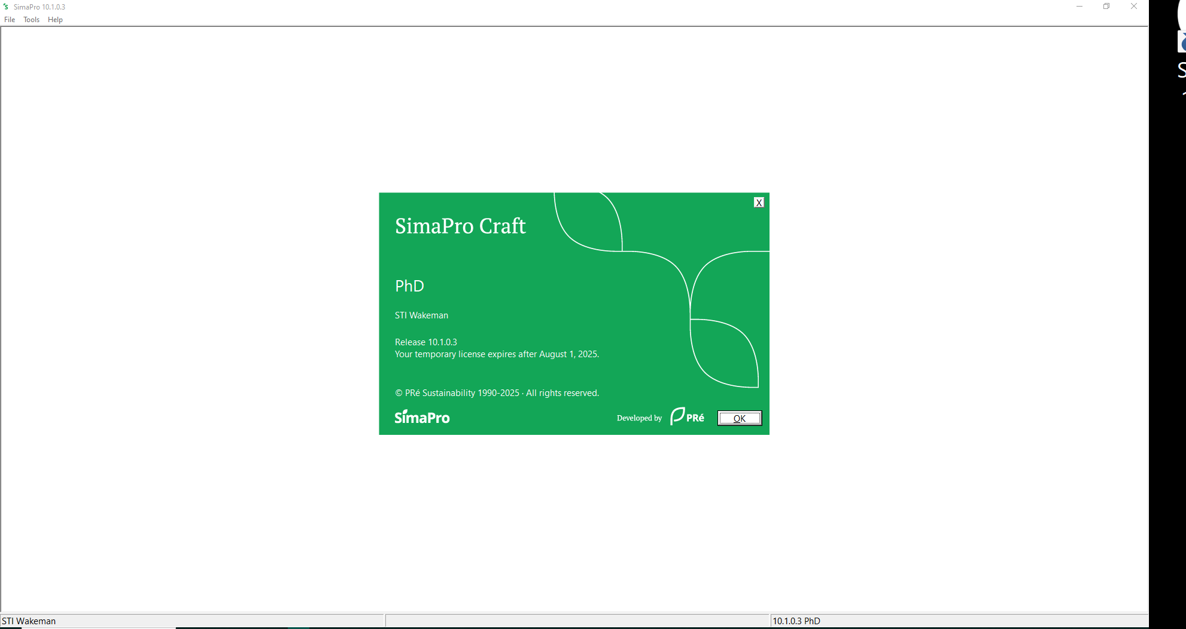
If you decide to install Simapro 10.1, and want to use EN15804 database
Installation is the same, with the same procedure for downloading the database EN15804

Slide 25
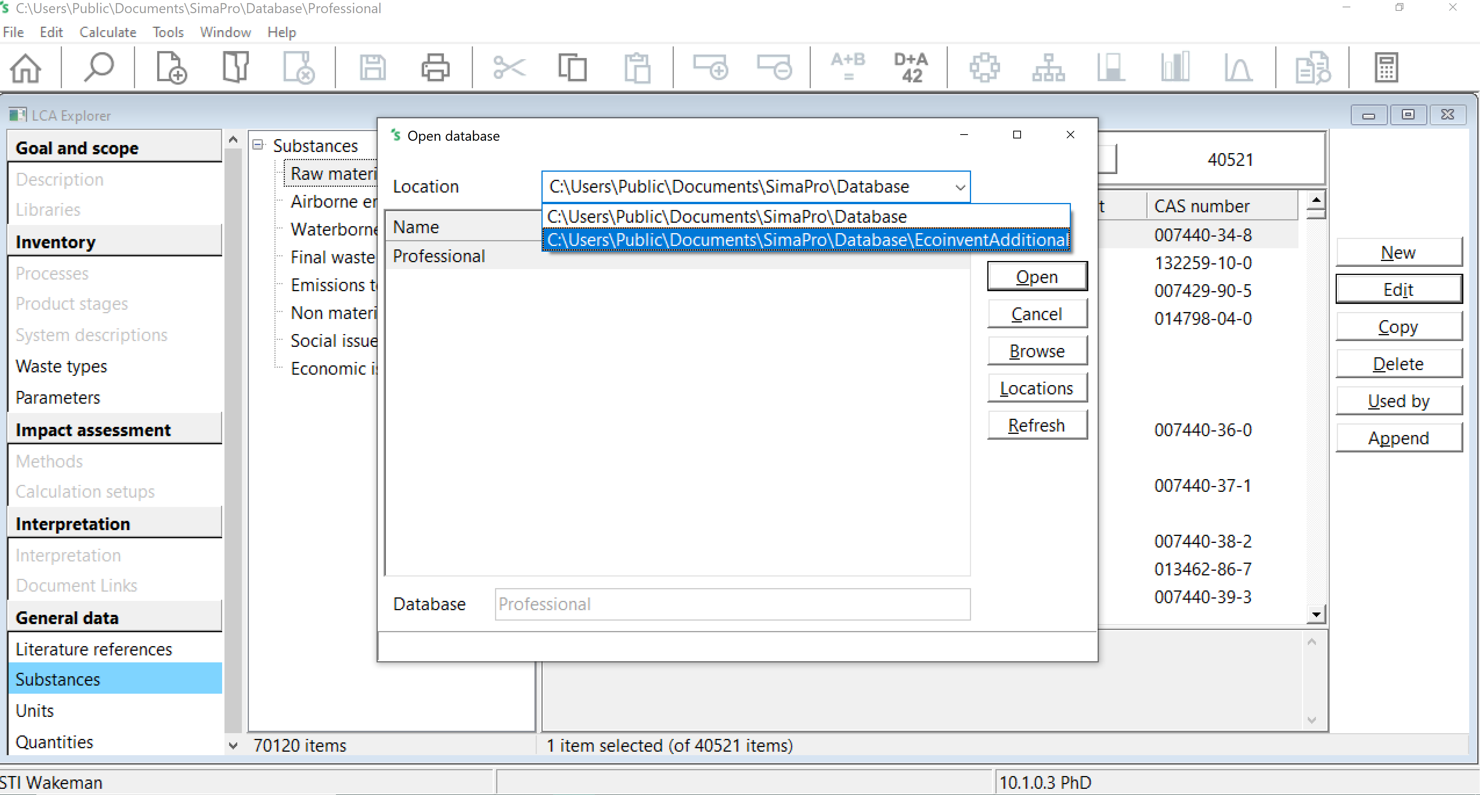
Before importing the EN15804 database,
File > Open Simapro Database
And select the Ecoinvent310_EN15804 → It will update the database to be readable by the new Simapro 10.1 version

Slide 26
Then, you can import the database (from slide n°19)

